Slide 1

Survey Distribution, Bikeshare Station Siting Updates
Hannah DeBruin
Weekly Meeting: Transit Data Subgroup
01/24/22

Slide 2
Survey Distribution Feedback
Agency | NTD Monthly Avg | Reported # Riders | Free Ride Incentive | Email List | Text List | Stock Paper Survey On Board | Tablets | During Call | Staff in Vehicles
Prairie Five Riders | 10730 | 957 | Yes | No (c) | No (c) | Yes | No | No | No
Morris Transit | 4378 | 357 382 | No | No | No | Yes | No | No | No
United Community Transit | 377 | 1400 34 | No | No | No (c) | Yes | No | No | No
Central Community Transit | 29423 | 1000 2624 | No | No | No | Yes | No | No | No
Transit Alternatives | 7627 | 5000 680 | Yes | No | Yes | Yes | 3 (14 veh) | Yes | Yes, on some trips
Tri-Cap Transit Connection | 10394 | 3500 927 | No | No | No | Yes | 15 (16 veh) | No | Yes, on some trips
Weekly Meeting (01/24/2023)
Hannah DeBruin
Notes:
did united community transit numbers trend upward? central community transit numbers trend downward?

Slide 3
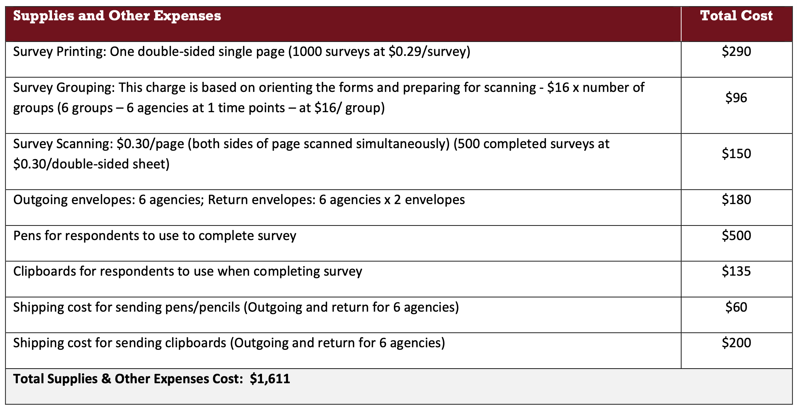
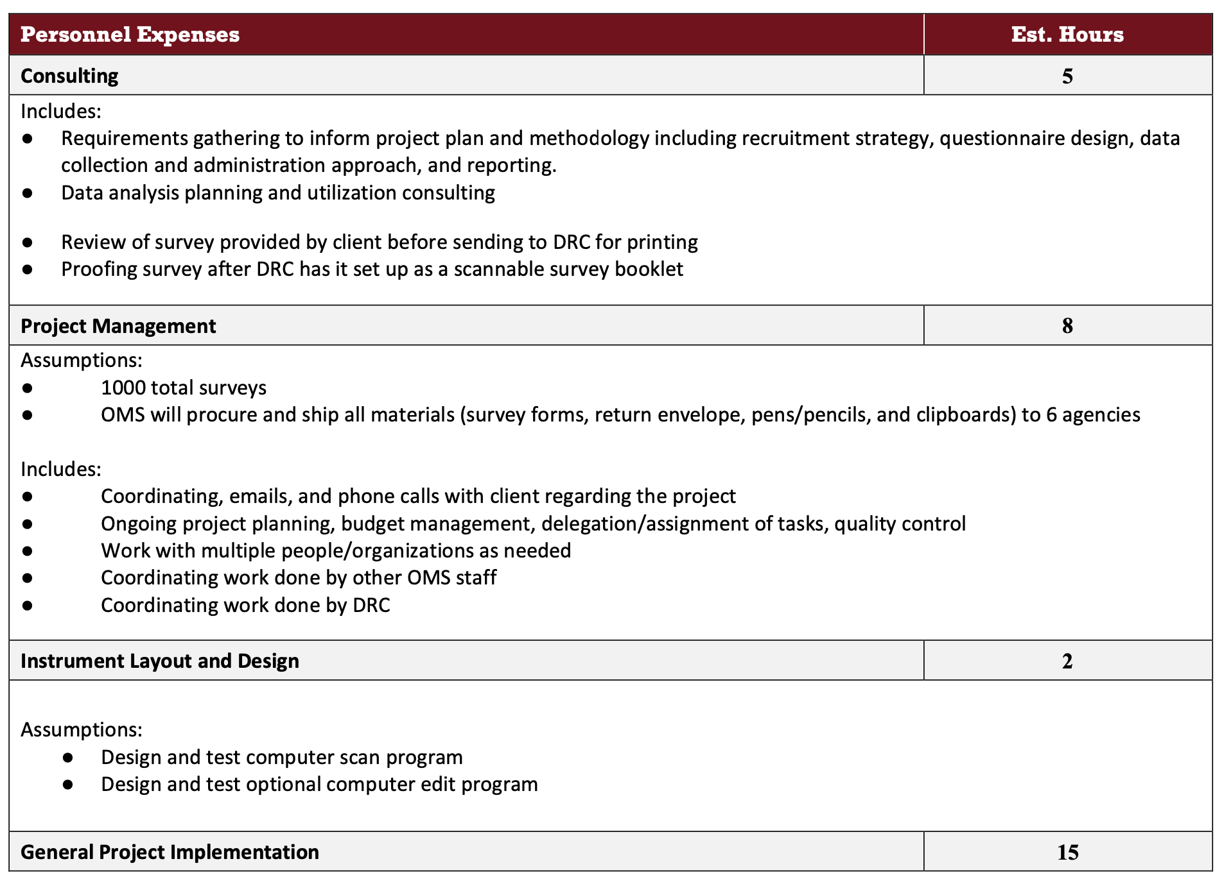
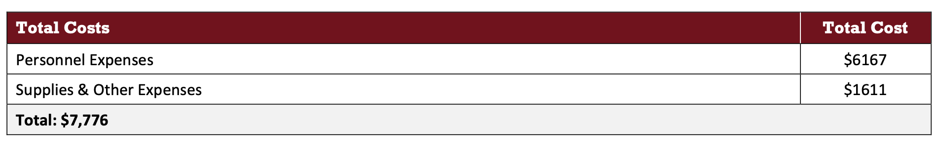
Office of Measurement Quote
Weekly Meeting (01/24/2023)
Hannah DeBruin
Notes:
did united community transit numbers trend upward? central community transit numbers trend downward?

Slide 4
Bikeshare Station Siting
Updates:
Figured out how to do distance constraint!
  “Generate Near Table” within a quarter mile search radius, and add i + j <= 1 constraint for those pairs
Generalized GIS modelbuilder and python code to any set of data (max, min functions, etc)
Improved assigned points for commercial parcels/employer centers using log10() functions
  Highest AMT (ksft), employees become smaller so that the range of points 0-10 is better distributed
What’s Next (Before end of month):
Fix set coverage constraints (reading the values one ”i” off and causing infeasible constraints) – easy
Better sampling method (something generalizable) – more effort
  Random selection within each zone
  Selection of top quadrant of points within each zone
  Tools to try out include:
    splitting layer into n different layers based off n zones (need to look into workspace setup)
    select points from each zone and generate a new sample with a “for” iterator (need to learn tool, SQL)
Weekly Meeting (01/24/2023)
Hannah DeBruin

Slide 5
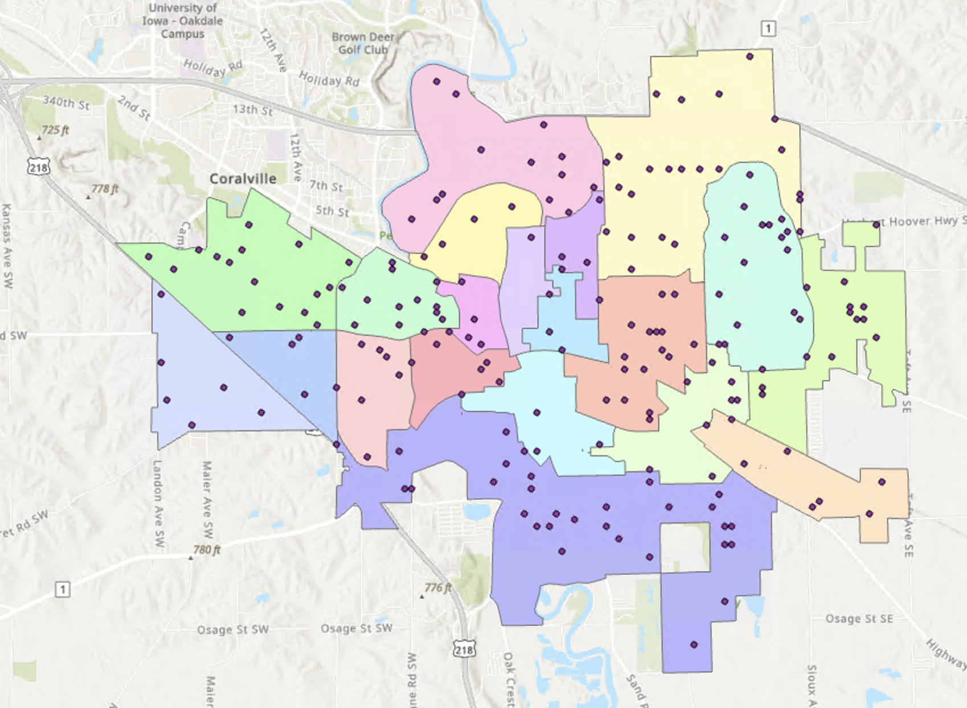
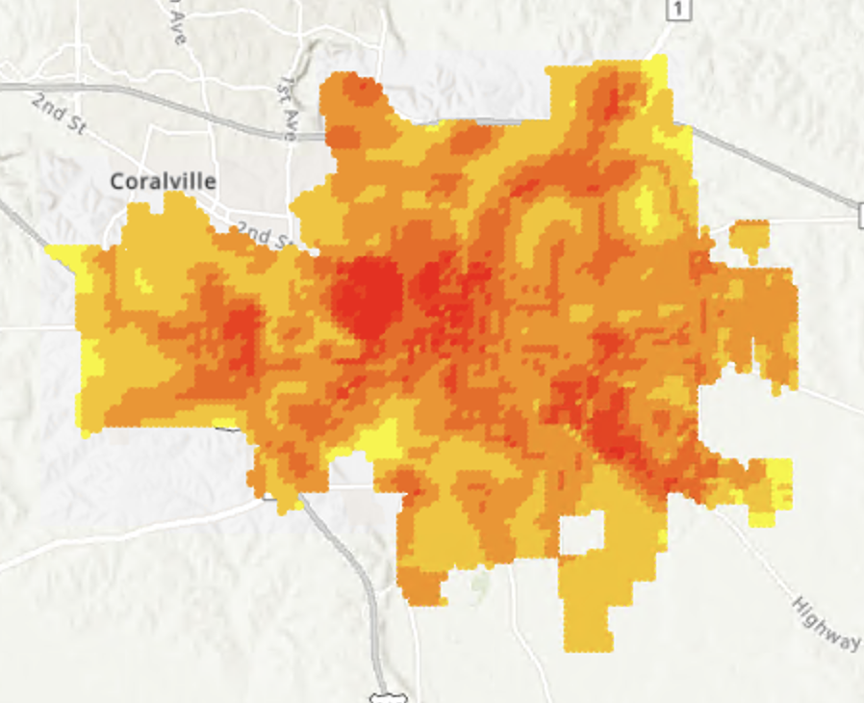
Bikeshare Station Siting
Weekly Meeting (01/24/2023)
Hannah DeBruin

